Slide 1

Predicting Changes in Bitcoin Price to Get Rich Quick
Jacob Shaw

Slide 2
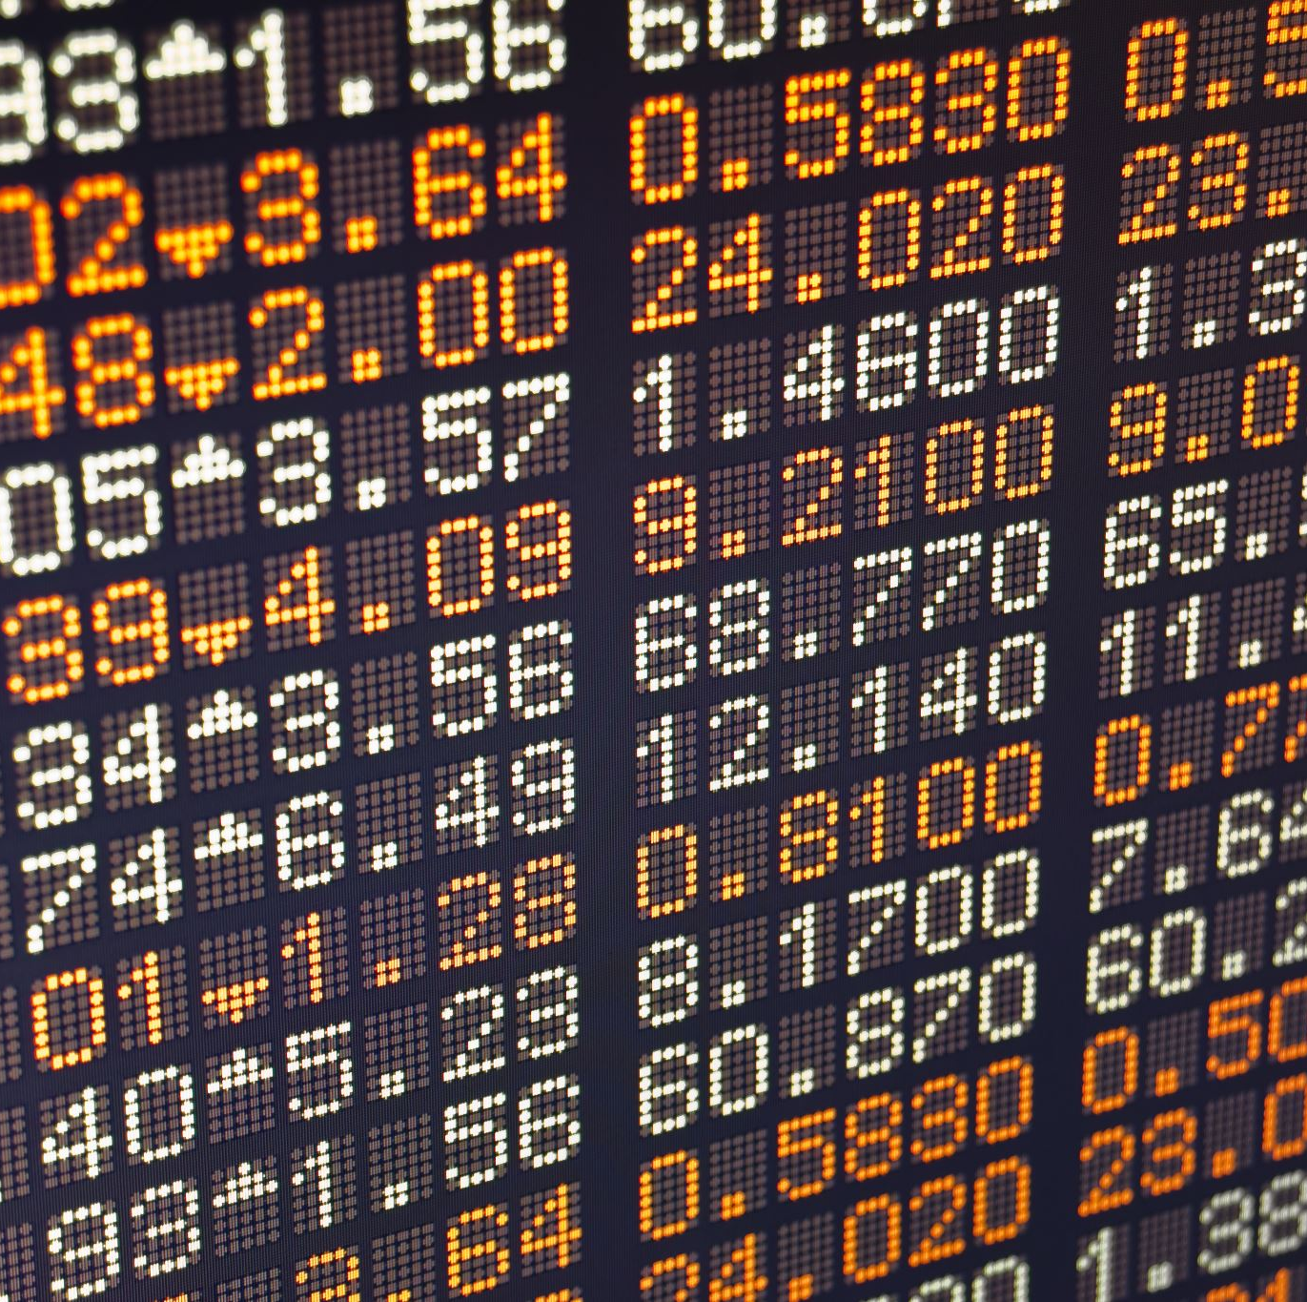
Problem Statement
In the volatile market that is cryptocurrency, can we accurately predict Bitcoin prices on a minute-by-minute basis and then turn those predictions into actual profits?
Goal: Make as much money as possible

Slide 3
Dataset
From Kaggle: G-Research Crypto Forecasting Competition
Provided two training datasets, which I combined into one
Added additional Fear Greed Index Dataset
Additional Dataset:
Bitcoin Fear and Greed Index
4 years of Index Data per day
From Kaggle:
Bitcoin Fear and Greed Dataset
Original Dataset:
4 years of price data
14 popular cryptocurrencies
Nearly 27 million rows of data
Notes:
Fear and Greed Index: Gauges the overall sentiment of the market and determines if assets are fairly prices. When there is excess fear in the market, this will drive prices down, whereas too much greed will drive prices up.

Slide 4

Preprocessing
Filtered to just Bitcoin
Most popular and most data
Redefined Target Variable
Open – Close by minute
Handle missing values in VWAP
Train Test Validation Split
70%, 20%, 10%
Notes:
Filtered to just Bitcoin for computational reasons. It is the most popular crypto and had the most data.
Redefined the target variable to be the opening price minus the closing price by minute. More ambitious and more well defined than the provided target variable.
Handled some missing data by imputing numbers that made sense for each context. For example, there were some missing values for VWAP (The volume weighted average price for the minute) that I replaced with 0s because there were no trades in that time period.
Settled on a train test validation split of 70, 20, and 10

Slide 5
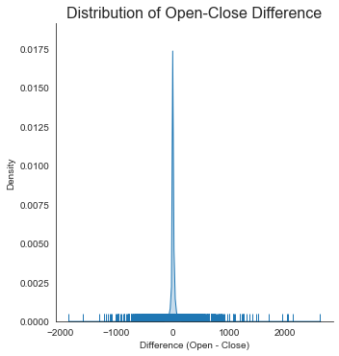
Handling Outliers: Drop vs. Manipulate
Target centered around $0.00
Range from -$1842.88 to $2616.55
Too large
Solution: Drop or Manipulate outliers
Notes:
So looking at the distribution of the target variable, we can see that it is centered just above 0. Therefore, the average difference in open minus close price per minute is close to nothing. However, there are some massive outliers in the target. The range goes from a loss of -$1800 to a gain of $2600. Simply put, there is no way that we can create a model that would accurately be able to predict those changes for one minute in the market, so I decided to handle the outliers in two different ways.

Slide 6
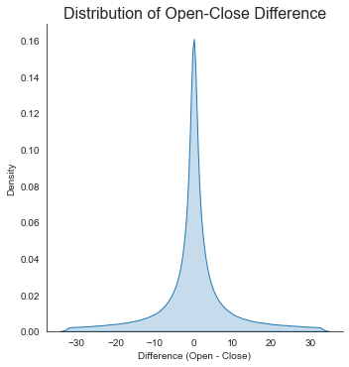
Handling Outliers: Drop vs. Manipulate
Centered around $0.00
Range from -$1842.88 to $2616.55
Too large
Solution: Drop or Manipulate outliers
Dropped 5% of data from top and bottom of range
Notes:
First solution was to just drop the outliers from the dataset. This results in a much better looking distribution.

Slide 7
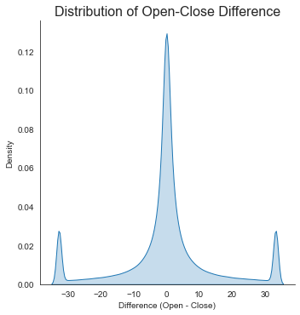
Handling Outliers: Drop vs. Manipulate
Centered around $0.00
Range from -$1842.88 to $2616.55
Too large
Solution: Drop or Manipulate outliers
Change top and bottom 5% to be the value of the 95th and 5th percentiles, respectively
Notes:
The next option is to manipulate the outliers by changing the top and bottom 5% values to be equal to the 95th percentile and 5th percentile, respectively. This provides an interesting looking distribution, but it will be interesting to see how the results turn out by continuing to let those extreme values influence our dataset. I implemented both of these methods into 2 different models, so we’ll look at their effects in a few.

Slide 8

Feature Engineering:
Create Historic Asset Returns
Calculates % change in asset prices over different time intervals
1, 2, 3, 5, 10, 15, 20, 30, 40, 50, and 60 minutes
Create Moving Average
Calculates the moving average of the % change over different window sizes
5, 10, 15, 20, 30, 40, 50, and 60 minute windows
Notes:
Moving into feature engineering, I initially wanted to build a DNN, which meant I should factor in some time series data. For starters, I created a new variable called Historical asset returns, which calcs the % changes in asset prices over different time intervals. These time intervals are for 1,2,3,5,10,15,20,30,40,50, and 60 minutes. Next, I created a new variables called Moving average, which calcs the moving average of the % change over different window sizes. These window sizes are 5,10,15,20,30,40,50 and 60 minute windows. Now that these features are created, lets build the models.

Slide 9
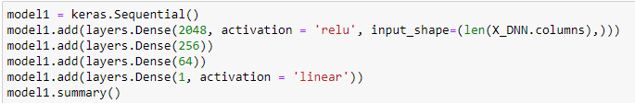
Model 1 – DNN w/ outliers removed
Dropped outside 5% of target data
4 fully connected dense layers
584,065 trainable parameters
Run time: 30 minutes
Notes:
First model I built was a fully connected DNN w/ the outliers removed. You can see the architecture in the code above. In the end, this model had 584000 traininable parameters.

Slide 10
Model 2 – DNN w/ outliers scaled down
Scaled down outside 5% of target data
4 fully connected dense layers
584,065 trainable parameters
Run time: 30 minutes
Notes:
The next model I built Is the exact same model as before, but with the outliers scaled down to their max percentiles instead. In total, both of these models took around 30 minutes to run.

Slide 11

Model 3 – XGBoost
Number of estimators = 1000
Learning rate = .01
Max_depth = 11
Run time: ~ 1 Hour
Notes:
For my last model, I wanted to build a LSTM. However, the models I was building was taking at least 4 times the amount of time as the DNN, but with the same results. I scrapped this model and decided to build a XGBoost model instead. An XGBoost Model: A version of gradient-boosting decision trees, which is very popular due to its tendency to yield highly accurate results. For the parameters…
Now lets look at how these models performed

Slide 12
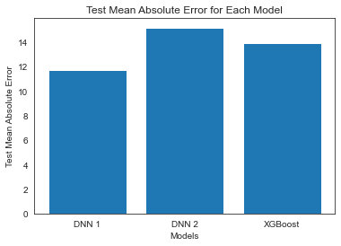
Model Comparison
DNN 1 is best performer on test data
But this data has been manipulated…
Notes:
So, when comparing the Mean Absolute Error for each model on the test dataset, we can see that the first DNN performed the best, with a MAE of roughly 11.5. The interpretation of this is that the model is off by $11.50 on average in prediction Bitcoin prices. This is not ideal, but it can get even worse when we consider that this data has been manipulated.

Slide 13
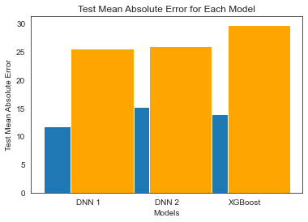
Model Comparison
When using real life data, DNN 1 still performs best
DNN 2 has improved
Notes:
Comparing the models performance to the un-adjusted targets shows that when faced with real life data, our models Mean absolute error has increased. The DNN models are now both around $25. But, we are less interested in this, and more interested if we can make money using this model

Slide 14
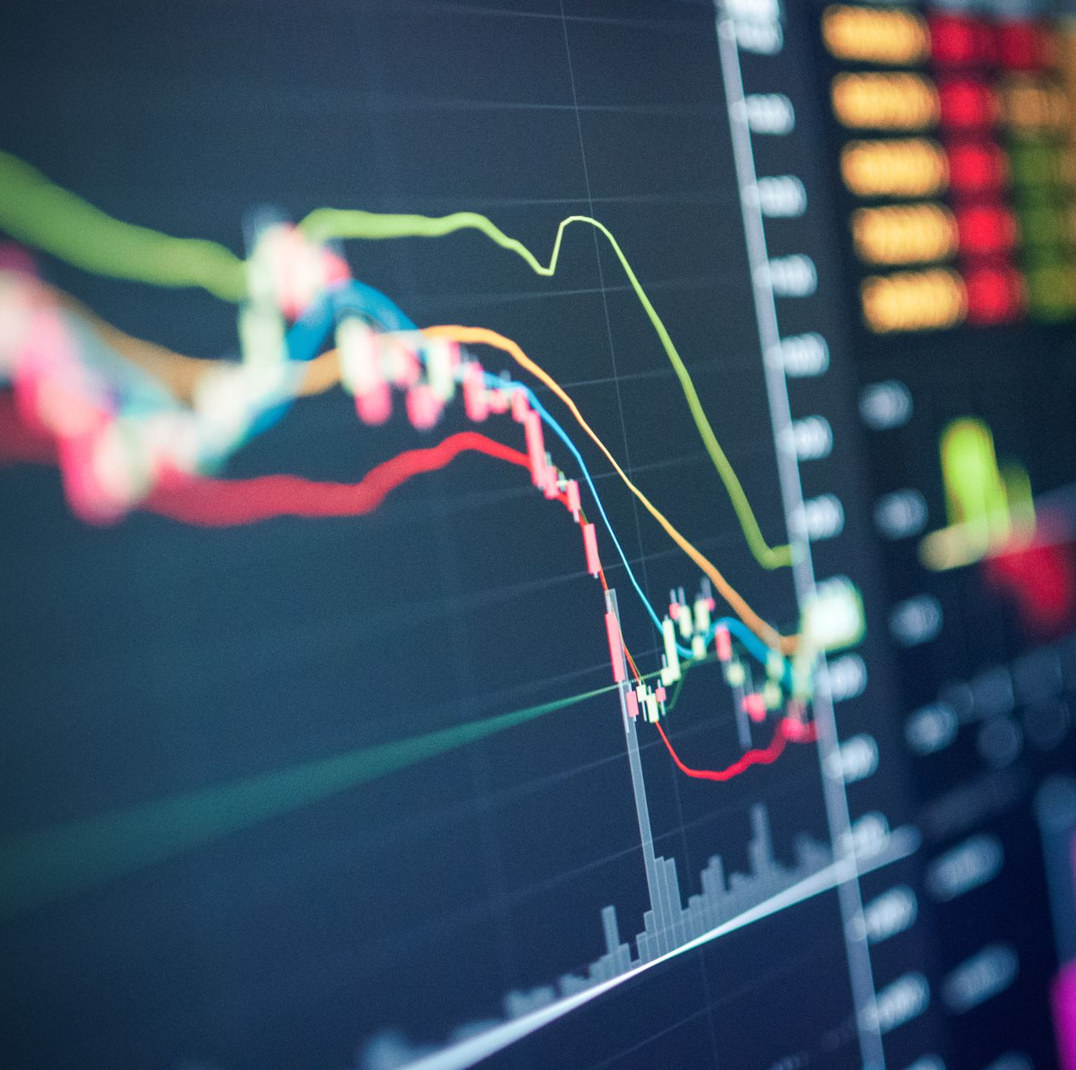
Create Trading Logic:
Build a function that takes in predictions from the models and unseen test data
Calculate the predicted percent change in $ amount
(Prediction / Open Price) * 100
For the highest .01% predicted percent gain, buy 1 Bitcoin at open price and sell it at close price one minute later
For the highest .01% predicted percent loss, sell 1 Bitcoin at open price then buy it back at close price one minute later
Notes:
So, I created a function that takes in predictions from the models and unseen test data, and calculates the predicted percent change in a $ amount. Then, blah. Now, lets see how each of the model performs in real dollar amounts.

Slide 15
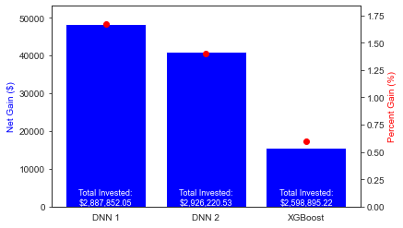
Model Comparison in Real Dollars
Notes:
So, this graph displays the Net gain from executing trades using my trading logic, the total amount invested, and also the percentage gain. As you can see, the highest performing model would require nearly $2.9 million invested to just make $48,300. This is a percent gain of 1.67%, the other models perform worse. Additionally, this would not factor in any trading costs associated. So, in case any of you were interested in using my model to try to make money, I’ll offer you some alternatives.

Slide 16

Some Alternative Options…
S&P 500:
Average return of 9.26%
Notes:
S&P 500 returns 9.26% on average

Slide 17
Some Alternative Options…
S&P 500:
Average return of 9.26%
US 2-year bond:
4.64%
Notes:
The US 2-year bond returns 4.64% currently

Slide 18
Some Alternative Options…
S&P 500:
Average return of 9.26%
US 2-year bond:
4.64%
AMEX Savings Account:
APY 4.35%
Notes:
Lastly, you could open an AMEX savings account and earn 4.35% APY. If for some reason you’re still interested in using my models, I suggest you to take a course on investing.

Slide 19

Why Did My Models Perform Poorly?
Overambitious Target
Model Complexity/Computational Limits
Noisy Data/Nature of cryptocurrencies
Lack of outside data
Market manipulation
Notes:
So, why did my models perform so poorly? I believe the main issue was setting my target variable too ambitiously. Predicting 1 minute changes in Bitcoin price is incredibly difficult, especially given the noisy nature of cryptocurrencies. Cryptocurrencies are highly volatile, and working with that small of a time frame when swings can be greater than $2000 in a minute is pretty difficult. The next reason could be the complexity of the model required to truly capture these trends in the data. This brings us to computational limits, which I was already experiencing giving the models I made. Additionally, there could be some more external datasets that would’ve improved my model score. Lastly, Bitcoin market manipulation occurs fairly frequenctly, and refers to the coordinated efforts to artificially influence the price of Bitcoin through tactics such as spoofing, wash trading, or pump and dump schemes, exploiting the market's relatively low liquidity and lack of regulation. All in all, I had a good time creating these models, but I’m going to go ahead and say I won’t be using them to get rich anytime soon.

